Slide 1
Probability Related Problems
Prepared by: Syed Tauqeer Ahmed Hashmi

Slide 2
Question no. 1(a)
The 36 students in 8 Enriched were assigned three challenging problems, A, B and C. A poll of the classes, one week later, showed that each student had solved at least one of the problems. It also showed this additional information.
10 students had solved all three points
12 students had solved A and B
17 students had solved B and C
21 students had solved A and C
24 students had solved A
22 students had solved B
30 students had solved C
What is the probability a student solved problem C only?
What is the probability a student solved problem A only?
What is the probability a student solved exactly one problem?
What is the probability a student solved exactly two problems?

Slide 3
Venn Diagram
C
B
A
24-10-11-2=1
21-10=11
10 students had solved all three problems
12 students had solved A and B
17 students had solved B and C
21 students had solved A and C
24 students had solved A
22 students had solved B
30 students had solved C
12-10 = 2
1
11
2
10
7
2
3
22-10-7-2=3
30-10-11-7=2
17-10=7

Slide 4
Venn Diagram
Probability that a student solved problem A only is 1/36
C
B
A
Probability that a student solved exactly one problem is 6/36
1/36
Probability that a student solved exactly two problems is 20/36
11/36
2/36
10/36
7/36
2/36
3/36
Probability that a student solved problem C only is 2/36

Slide 5
Question no. 1(b)
In a class of 30 students, 17 play video games and 12 watch MTV. It turns out that 5 students play video games and watch MTV. A student in this class is to be selected at random.
What is the probability that a student plays video games?
What is the probability that a student watches MTV ?
What is the probability that a student watches MTV or plays video games, but not both?
What is the probability that a student neither plays video games nor watches MTV?

Slide 6
Venn Diagram
Video
MTV
12
5
7
6

Slide 7
Venn Diagram
The probability that a student plays video games is 17/30.
The probability that a student neither plays video games nor watches MTV is 6/30.
Video
MTV
The probability that a student watches MTV is 12/30.
12/30
5/30
7/30
6/30
The probability that a student watches MTV or plays video games, but not both is 19/30.

Slide 8
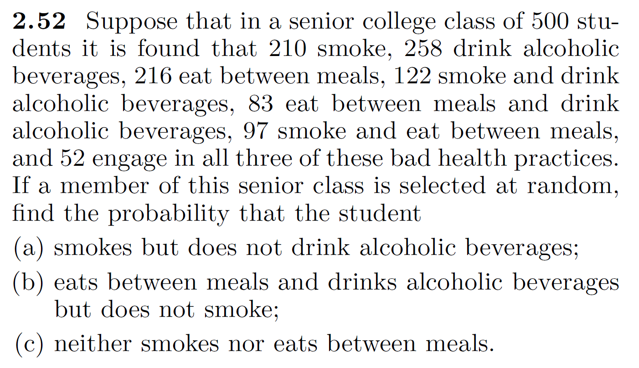

Slide 9
Thank You

